Slide 1
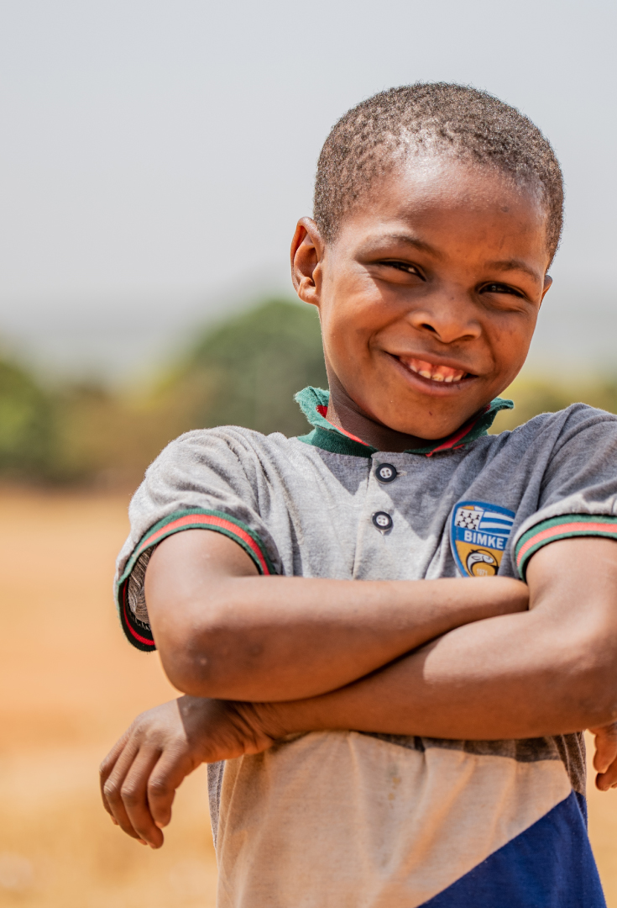

Compassion Sunday
Holy Trinity, Chesterton
2nd February 2025

Slide 2

Thank You !!

Slide 3


“It’s now out in the open for everyone to see:
A God-revealing light to the non-Jewish nations,
and of glory for your people Israel.”
Luke 2.32 TMB

Slide 4


Nearly 385m children
currently live in extreme poverty worldwide

Slide 5
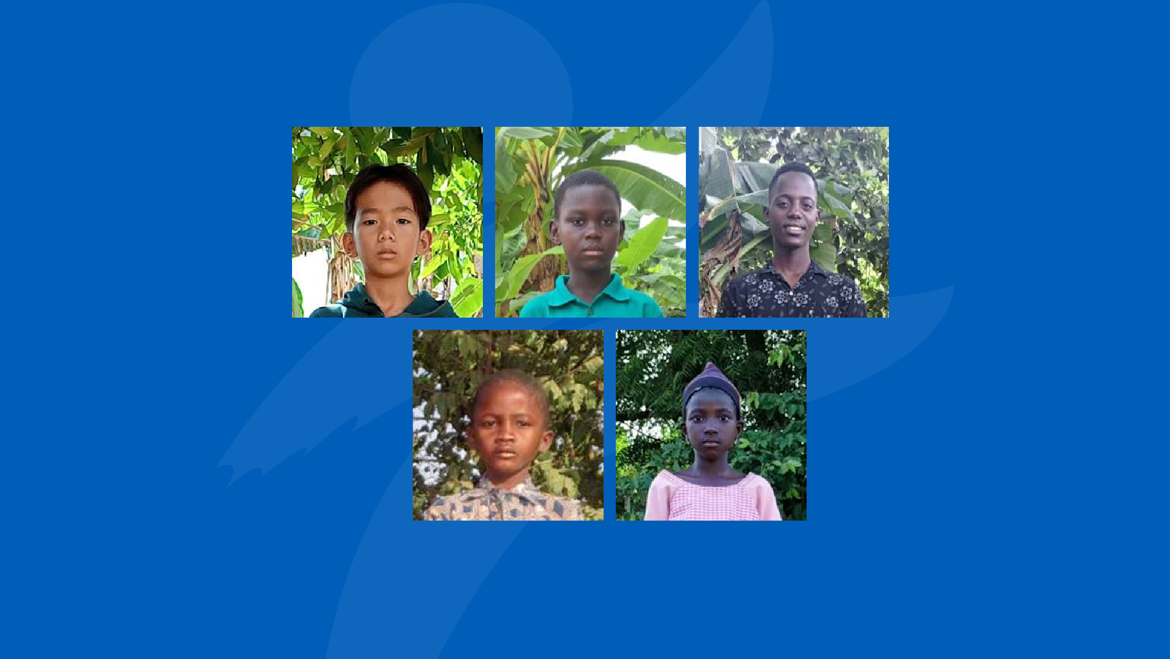

Daniel
Andi
Naomie
Godfred
Joseph

Slide 6
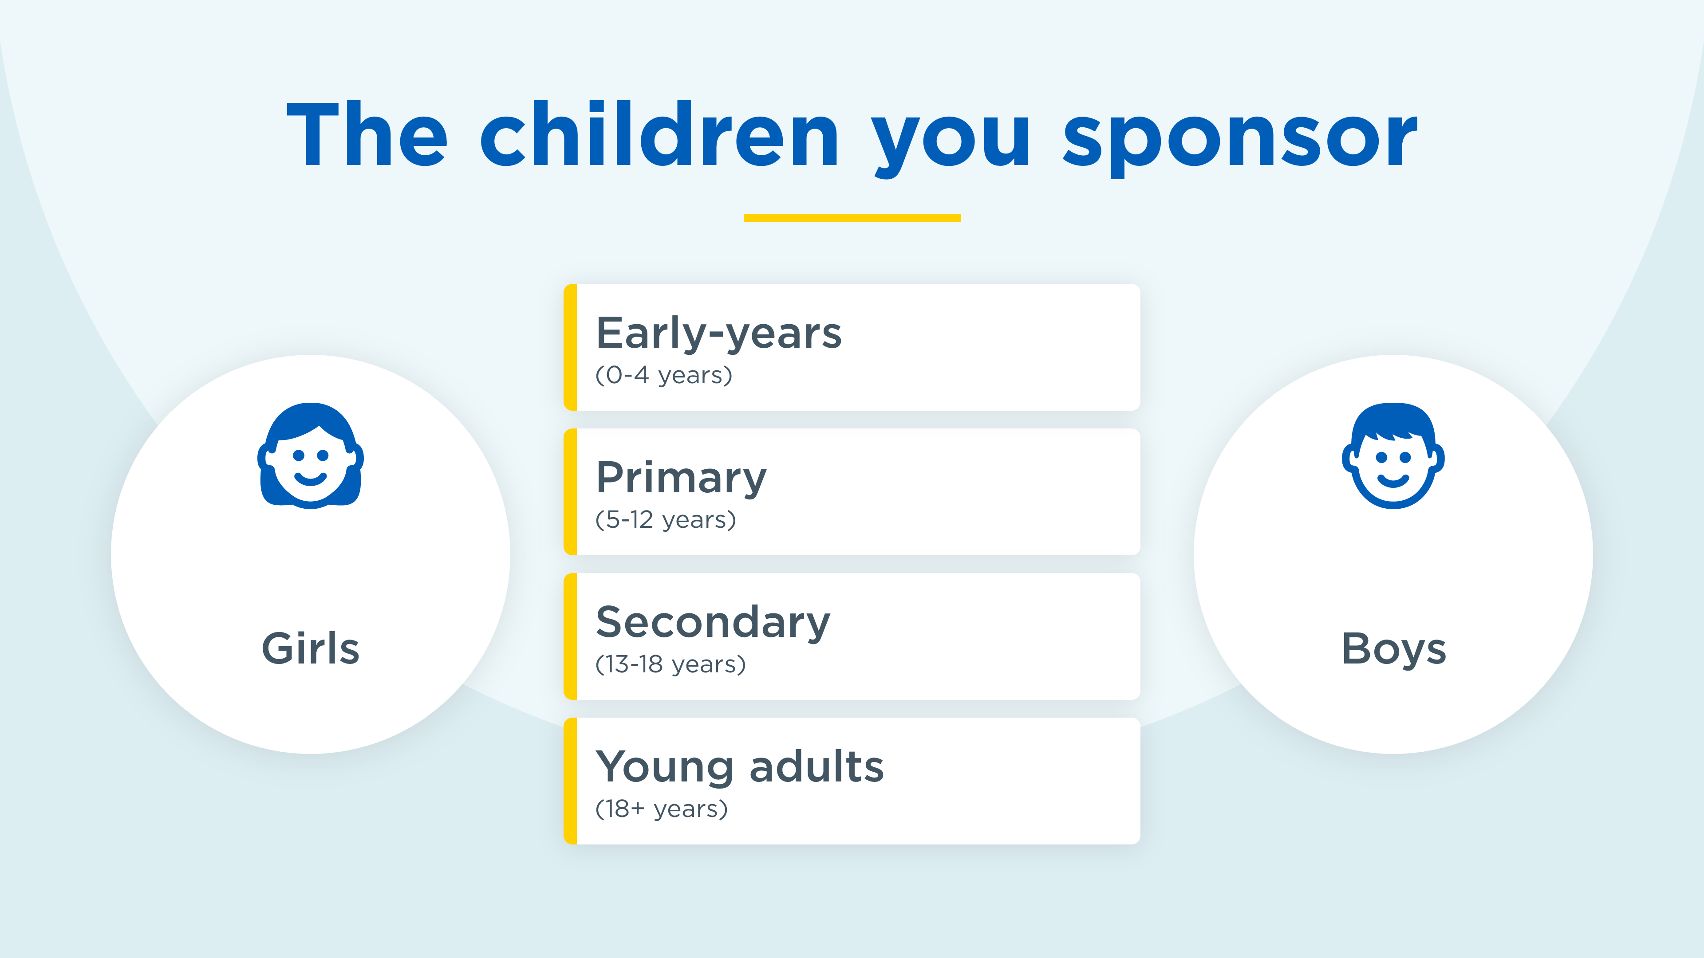
0
4
1
4
0
1

Slide 7





Your 5 sponsored children live in four countries
Guess which countries?

Slide 9
East
Indonesia (1)
Burkina Faso (2)
Ghana (1)
Uganda (1)

Slide 10
Burkina Faso (2)
Uganda (1)
Your 5 sponsored children
live in four countries.
East Indonesia (1)
Ghana (1)

Slide 11

About Compassion
25 countries in Asia, Africa, South
America, and Central America
Working with 8,000 churches
2m+ children & young people supported

Slide 12
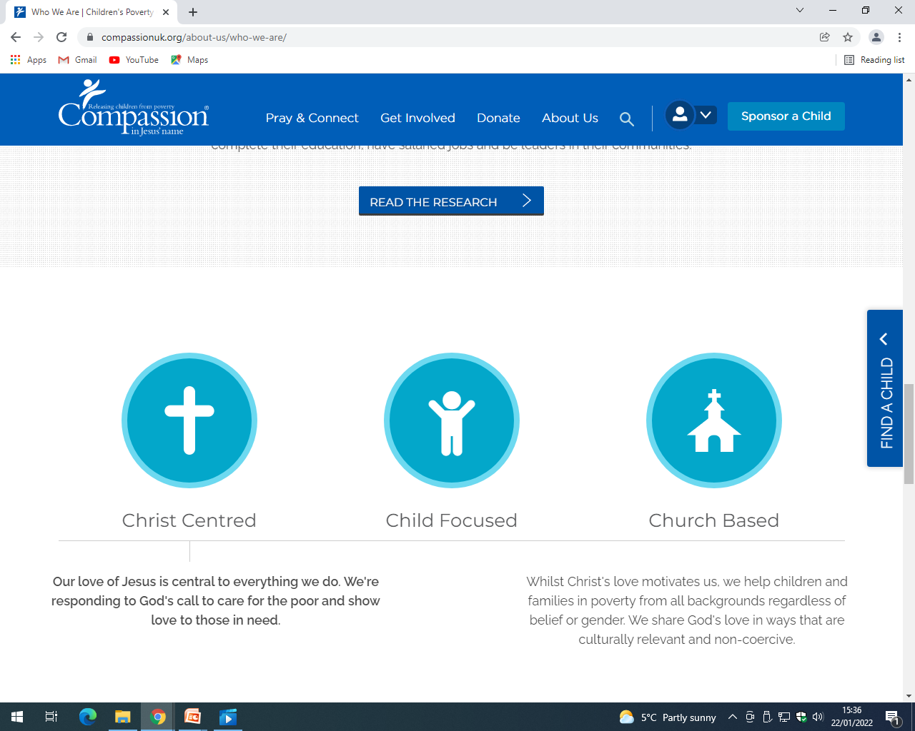
How Compassion Works

Slide 13
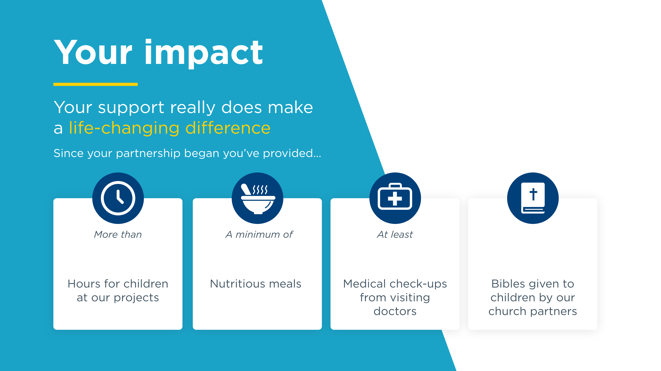
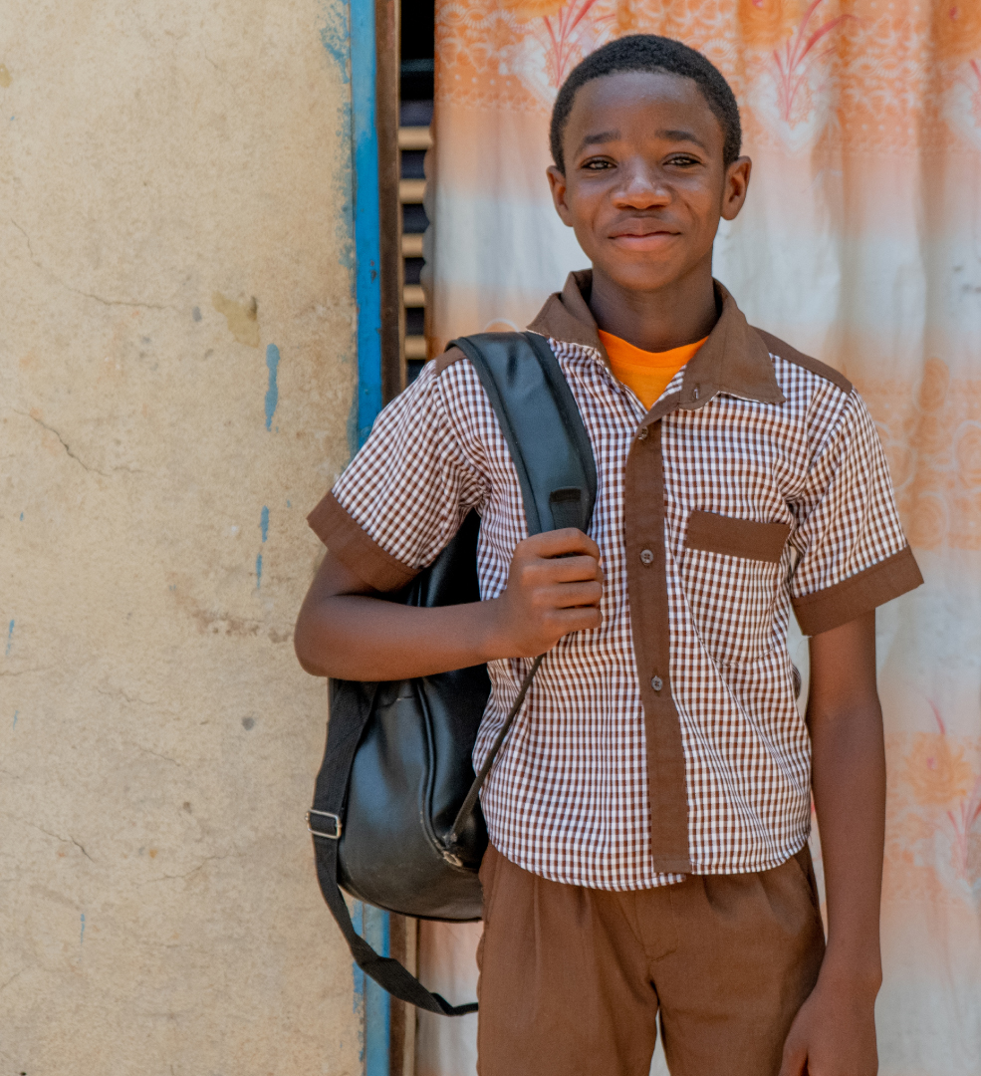
7,521
2,432
40
8

Slide 14

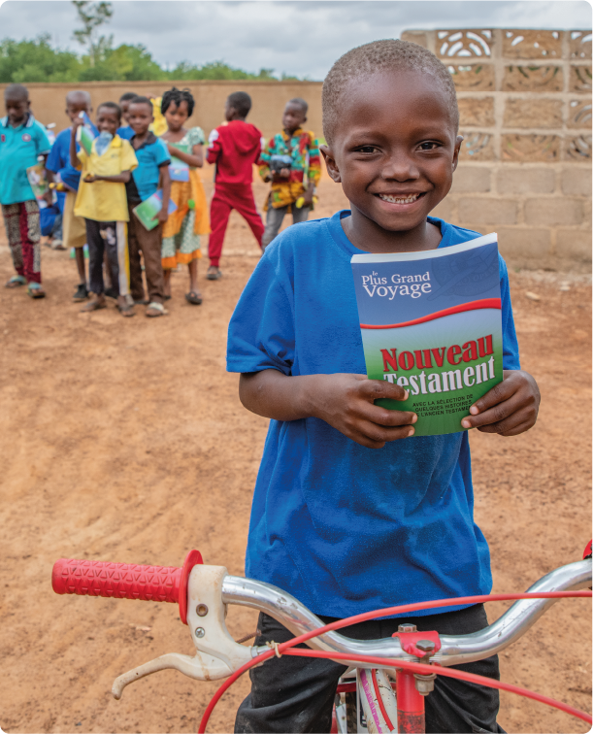
£1,992
5

Slide 15

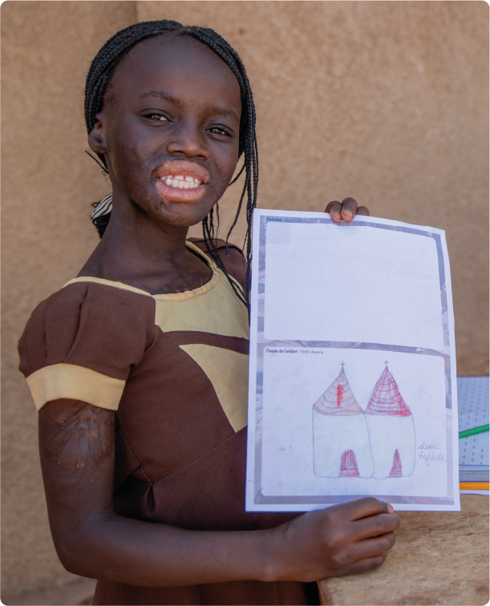

15
10
53% year-on-year
90% year-on-year

Slide 16

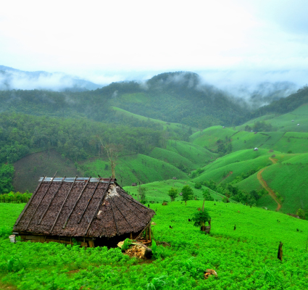
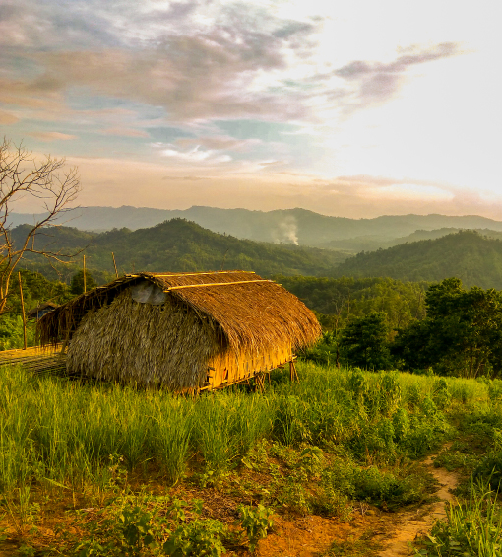
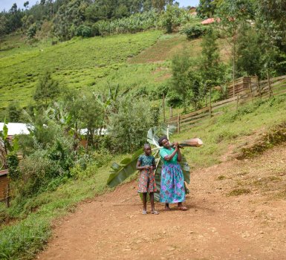
The neighbourhood
Most of the children you sponsor live in a rural location in a mountainous setting.
The most common house construction is mud, earth, clay and adobe, with wood roofs.

Slide 17
Video:
Hilda’s Story

Slide 18
“On the day when I act,” says the Lord Almighty
“they will be my treasured possession.
Malachi 3.17 NIV

Slide 19

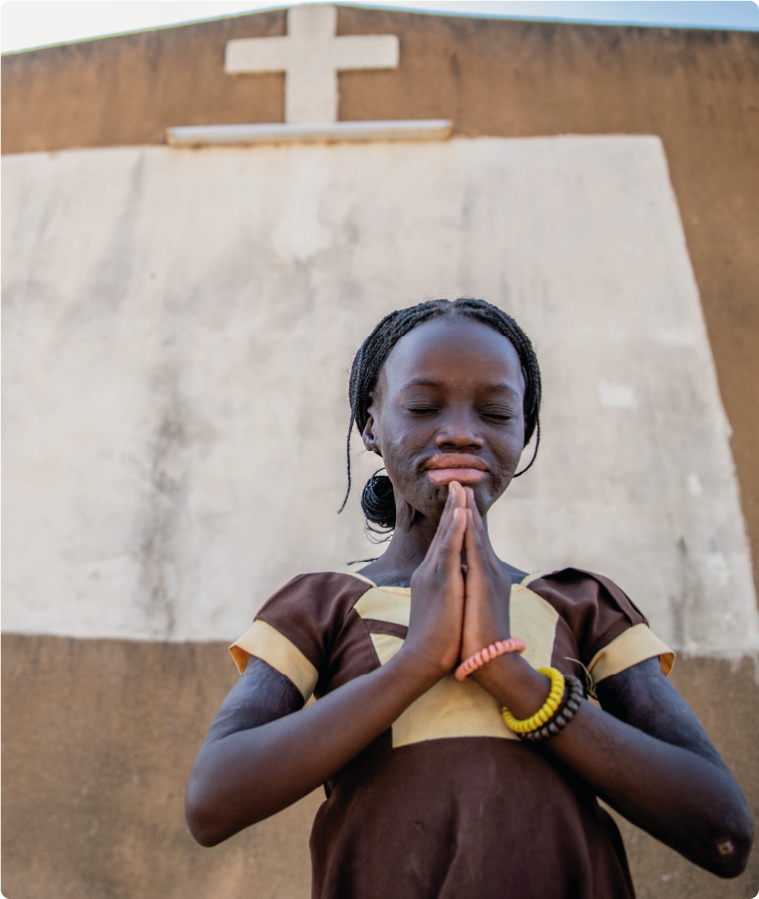
Holy Trinity, Chesterton

